Slide 1
Project Presentation of Industry Oriented Hands on Experience (22CS422)
On
SabziKart
Hyperlocal Grocery Shopping and Delivery App All Members Details
Supervised By- Ajay Kumar
Department of Computer Science and Engineering,
Chitkara University, Punjab
NAME | ROLL NUMBER
Chandrakant Kumar | 2211981133
Himangshu Choudhury | 2211981170
Gaurav Kumar | 2211981155
Gurveer Singh | 2210991602

Slide 2

Introduction
SabziKart is a modern, feature-rich online grocery platform bridging the gap between local vendors and digital shoppers.
Built using the MERN Stack, it provides a seamless, AI-driven experience for daily essentials with a focus on convenience and health.
SabziKart
2

Slide 3
Problem & Objective
The Problem
Manual grocery shopping is time-consuming. Consumers face a lack of price transparency, limited inventory tracking, and healthy dietary guidance.
The Objective
To develop a smart, multi-role (Customer/Seller/Vendor) platform that integrates AI assistance and secure payments for an efficient shopping journey.

Slide 4
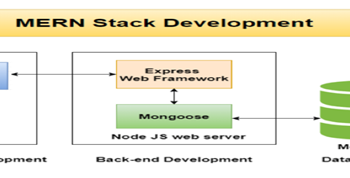
Architecture
SabziKart follows a high-performance three-tier architecture:
Frontend: React.js for interactive UI.
Backend: Node.js & Express.js for scalable API logic.
Database: MongoDB for flexible data storage.
Cloud: Cloudinary for image management.

Slide 5
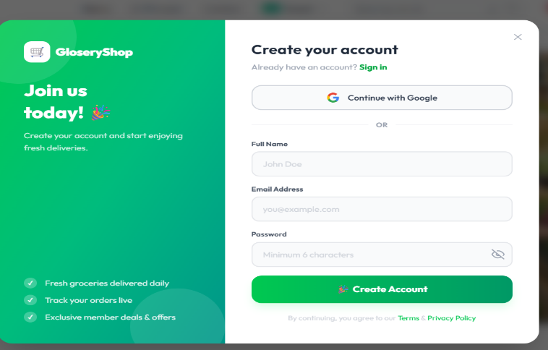
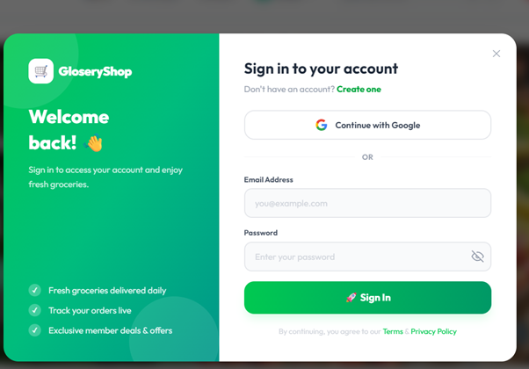
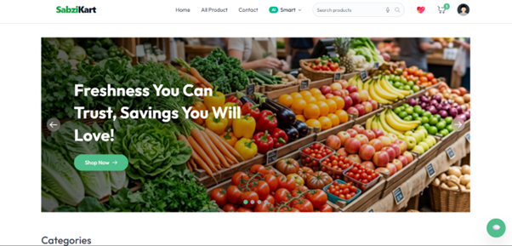
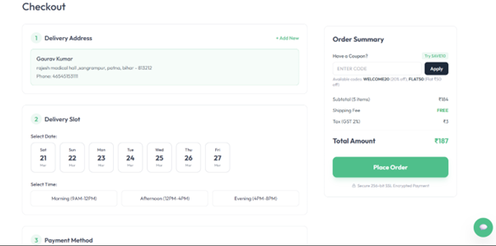
User Interface

Slide 6
Working
• The AI Grocery List Scanner is a pretty cool tool that uses Google's Gemini AI to look at pictures of your grocery list. It can figure out what you've written, whether it's handwritten, printed, or even just a photo of the actual item. Then, it shows you the matching products and you can add them to your cart.
• Vendor Dashboard — Vendors can accept, reject, pack, ship, and deliver orders; real-time stats (revenue, pending, delivered) with order search and filter.
• Seller Application System — Complete flow implemented: Seller registration → Admin approval → Password setup → Dashboard login; application status trackable via application number.
• All Products Page — Category, price (low/high), and rating filters with keyword search implemented; responsive product grid layout.
• Here's how it works: we use Google OAuth2 for logging in and JWT for registering, logging in, and logging out with an email and password. We also let users upload a profile picture using Cloudinary.

Slide 7


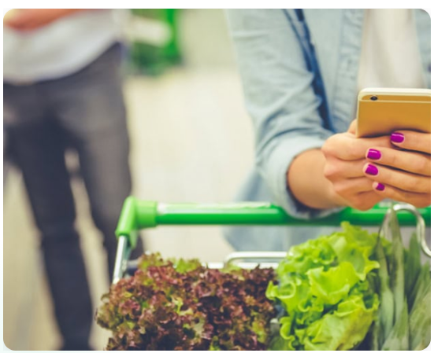
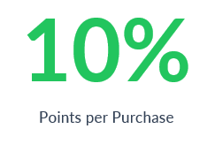
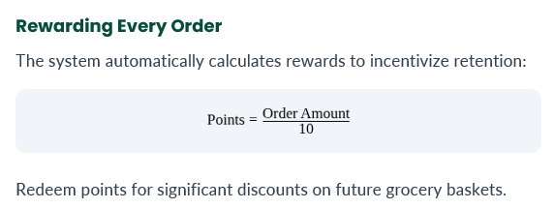
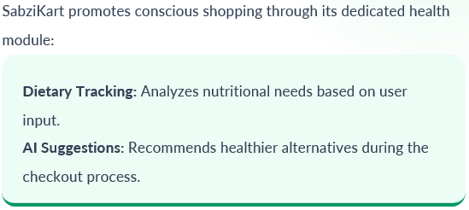
Extra Features

Slide 8
Results
• The AI grocery list scanner is really good at figuring out what's in your photos and matching them to the right items.
• Vendor dashboard fully functional — orders managed with real-time status updates.
• The seller sign-up process is now fully operational, with registration, approval, and login features all functioning as intended.
• Product filters, search, and user authentication working smoothly and securely.

Slide 9
Conclusion
SabziKart is a new way to shop for groceries online. It's a platform that makes buying fresh produce and daily essentials easy. The site is built using the latest technology, which means it's fast and easy to use. When you shop on SabziKart, you can see what's in stock in real-time, and you can even use a special tool to scan your groceries. The site also helps reduce waste and tracks deliveries in an eco-friendly way. Plus, you can earn rewards and loyalty points as you shop. For sellers, SabziKart makes it easy to manage their listings and keep track of sales. The platform brings local vendors and online shopping together, creating a community-driven marketplace that's good for everyone. With features like personalized shopping and smart checkout, SabziKart is changing the way we buy groceries online. It's a more sustainable and community-focused way to shop, and it's making a difference for both buyers and sellers.

Slide 10
Thank You
10

